Slide 1
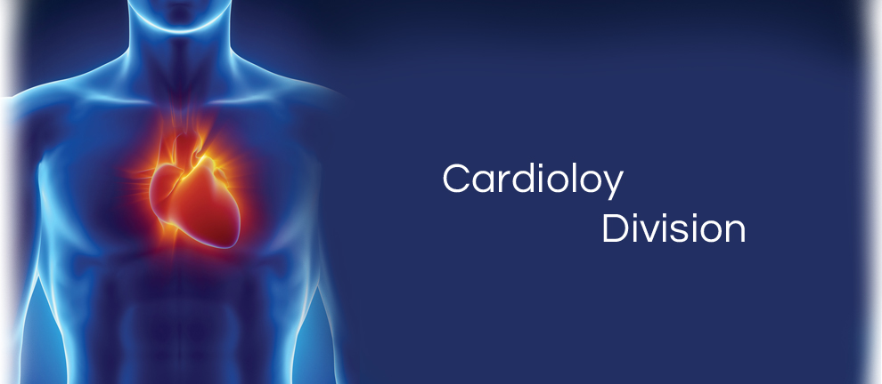
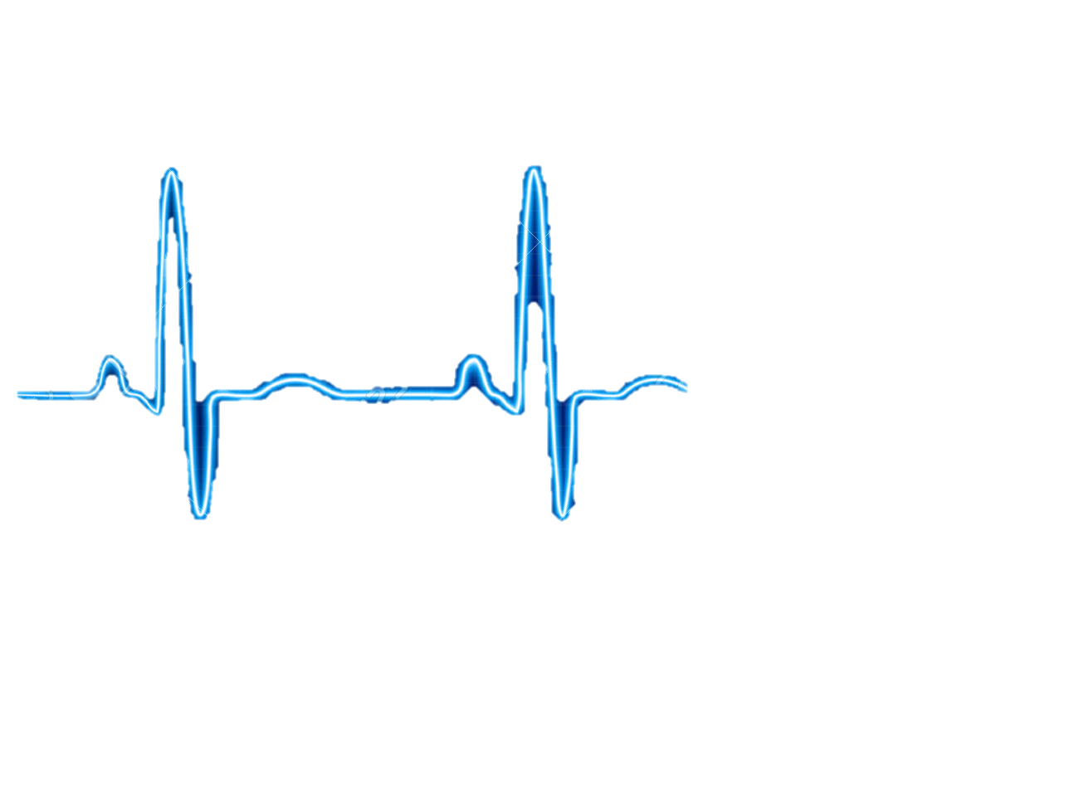
NEED FINDING
CARDIOVASCULAR TEAM
Qingbo Kang
Arthur Kohler
Chantelle Janeiro
Naghmeh Bandari
November, 2017

Slide 2
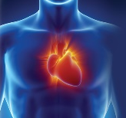

AGENDA
Team Members
Observations
Need Identification
Need Screening
Top Five Need Statements

Slide 3

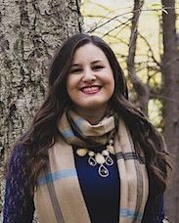
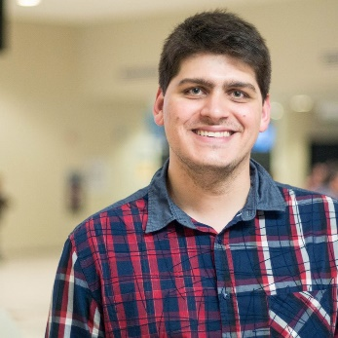
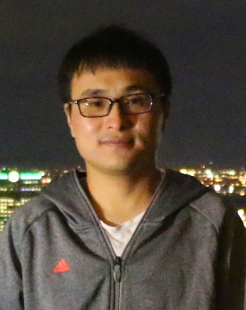
TEAM MEMBERS
Naghmeh Bandari:
- PhD. Student of Mechanical engineering, Concordia University (2016-Now)
- Therapy Development Specialist, CoreValve® TAVI, Medtronic® lnc. (2010-2015)
- Commerce and Regulatory Affairs Supervisor, Thoratec Corp. (2007-2010)
Chantelle Janeiro:
- MSc., Year 1, McGill University, Department of Experimental Medicine (Present)
Supervisor: Dr. Lorenzo Ferri; Research: Gastric Adenocarcinoma Peritoneal Metastasis
- BMSc., University of Western Ontario (2012-2017), Microbiology and Immunology
Arthur Kohler:
- Master Student in Engineering, with a concentration in Healthcare , ÉTS (2016-Now)
- Student in Biomedical Engineering, University of Technology of Compiègne, France (2014-Now)
Qingbo Kang:
- Master Student of Computer Science, Concordia University (2017-Now)

Slide 4
Observation
5 Hospital Visits
Two general visits, Glen Hospital, with Dr. Galli
One Coronary Artery Bypass Grafting (CABG), Glen Hospital, with
Dr. Lachapelle, Dr. Cecere
Two Transcatheter Aortic Valve Implantation (TAVI), Glen Hospital
With Dr. Lachapelle, Dr. Piazza

Slide 5
Need Identification
Total number of identified needs: 99

Slide 6
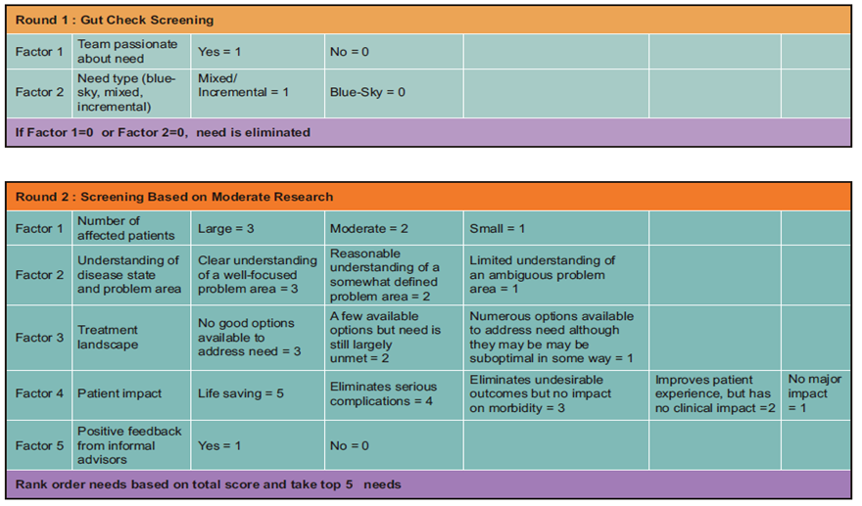
Number of Needs
Need Screening
99
25
5

Slide 7
Need 1:
A way to overcome the lack of wireless charging for medical devices that require an external power source, such as ventricle assist device, in patients with congestive heart failure, in order to improve convenience, maintenance, portability and quality of life.
Disease status:
Heart failure (HF) is a condition that the heart's pumping power is lower than healthy level. Consequently, the heart is not capable of pumping demanded oxygen and nutrients to the body.
At least 26 million patients worldwide
5.7 million people in the US
It is expected that by 2030 more than 8 million people will have this condition, with 46 % increase in prevalence

Slide 8
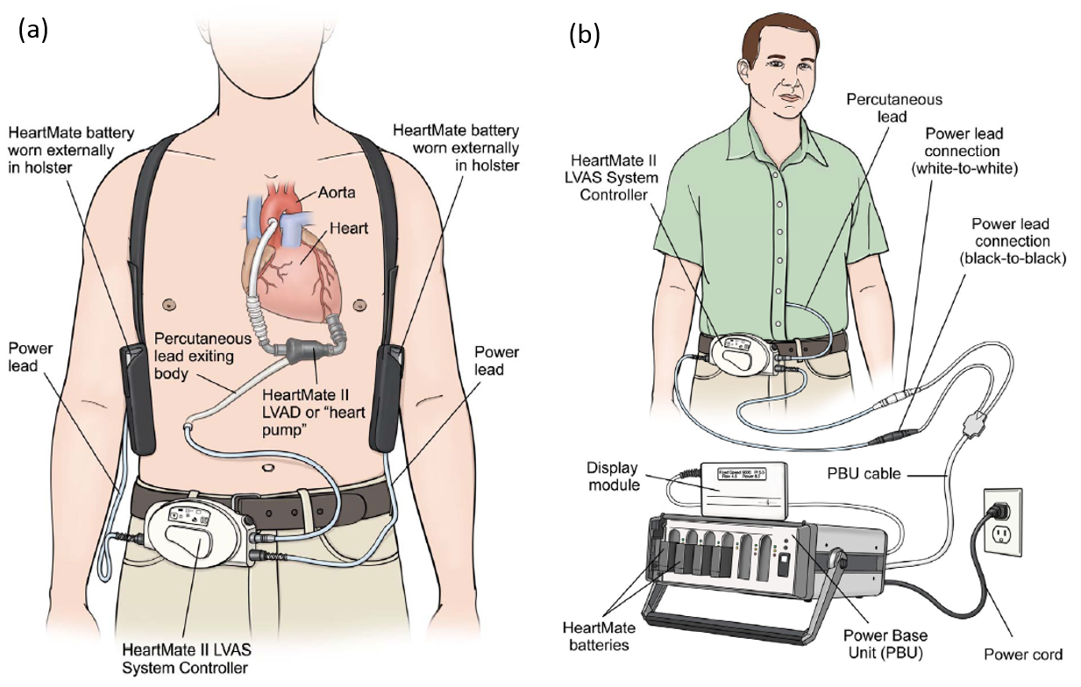
Need 1
Existing Treatment and Problem
Heart failure could be treated by Ventricle Assist Device (VAD), a small implantable device that act to compensate the pumping function of the heart and assist in circulating blood throughout the body.
VADs systems consist pump, system controller, power source, power leads, batteries and battery clips
VADs must always have power, either from batteries or electricity from the wall outlet
A power module or AC adaptor is used when the patient is not active, like when he is watching TV. It must be used when he is sleeping
Batteries should be exchanged when their charge falls below 25% capacity
Fully charged batteries should always be available or carried by backup bag

Slide 9
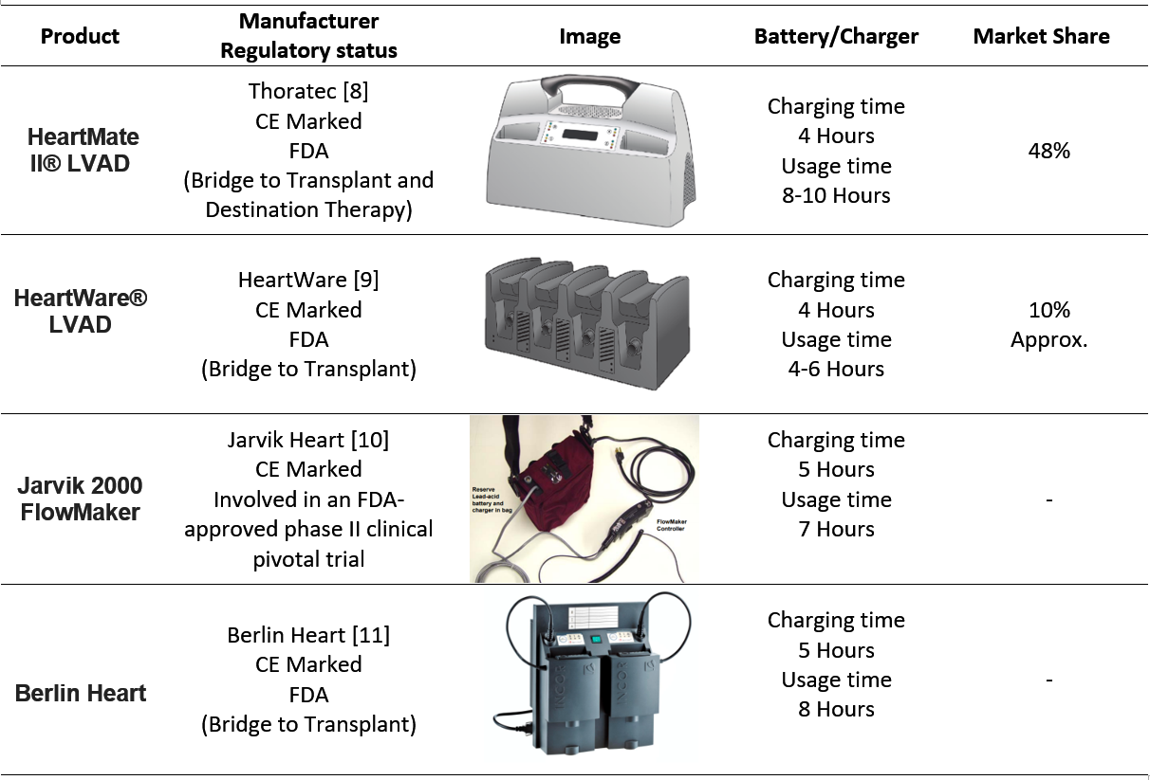
Need 1
Competitors

Slide 10
Need 1
Current Market for cardiac assistive devices
US | Global
770$ Million | 1.4$ Billion | Market Value (2017)
10.9% | 8.6% | CAGR (2010-2017)
Classification and Applicable Regulations for battery chargers for VAD
FDA-CDRH | CE | HEALTH CANADA
Device Classification: 1 Product Code: KRF Regulation Number: CFR 870.3670 | Device Classification: I Regulation: EEC/2017/745 | Device Classification: I Regulation: CMDCAS
Need Criteria:
the proposed need is subjected to the following criteria:
Lightweight, easy to carry
No need to backpack for reserve battery set
Firmware to track flows and battery charge with phone application

Slide 11
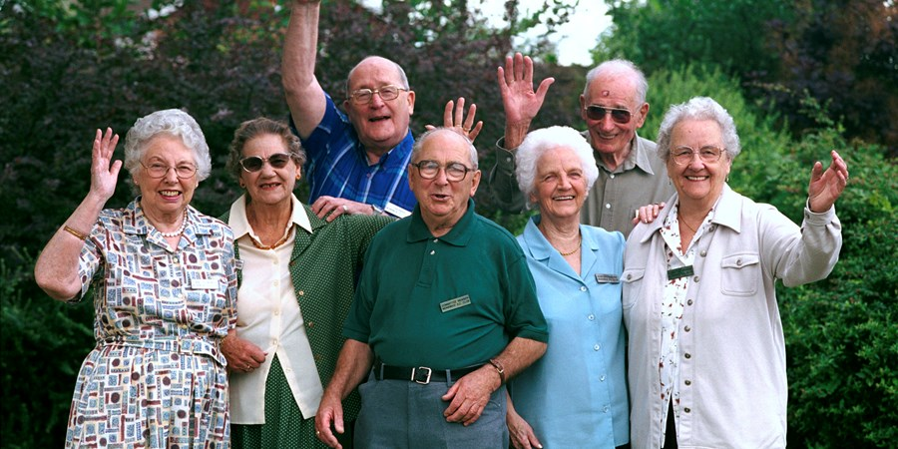
Need 2:
A way to more accurately determine the size of a heart valve during transcatheter valve replacement, in order to increase the accuracy and efficiency of choosing the proper valve.
Disease state:
Elderly population (80 years+) expected to increase
Prevalence in ~1 in 8 elderly aged 75 years+
1990 2050
6.9 M
25 M

Slide 12
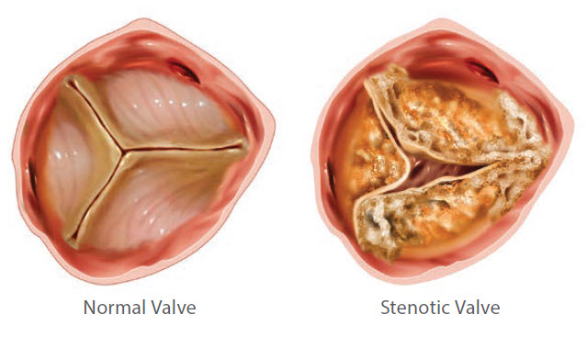
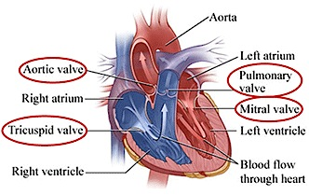
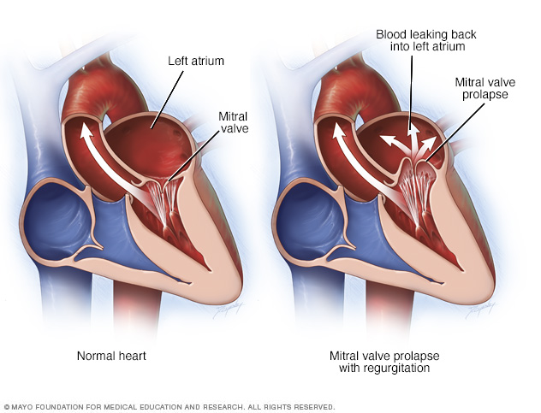
Disease State
Need 2
Valve disorders:
stenosis
prolapse
regurgitation
Stenosis: valve is sufficiently narrowed or stiffened.
Prolapse: leaflets don’t close evenly and collapse backward into the chamber that they are supposed to be sealing off.
Regurgitation: backflow of blood into the improper chamber.
Those at risk for valve disorders:
high blood pressure,
coronary artery disease,
rheumatic fever,
infective endocarditis,
heart attack or failure,
arrhythmias,
birth defects,
mediastinal (chest) radiation therapy for cancer

Slide 13
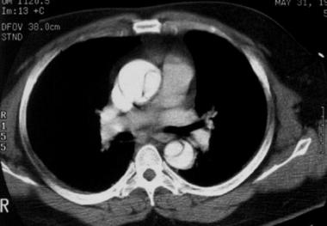
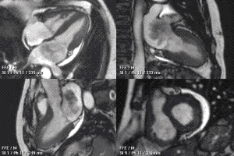
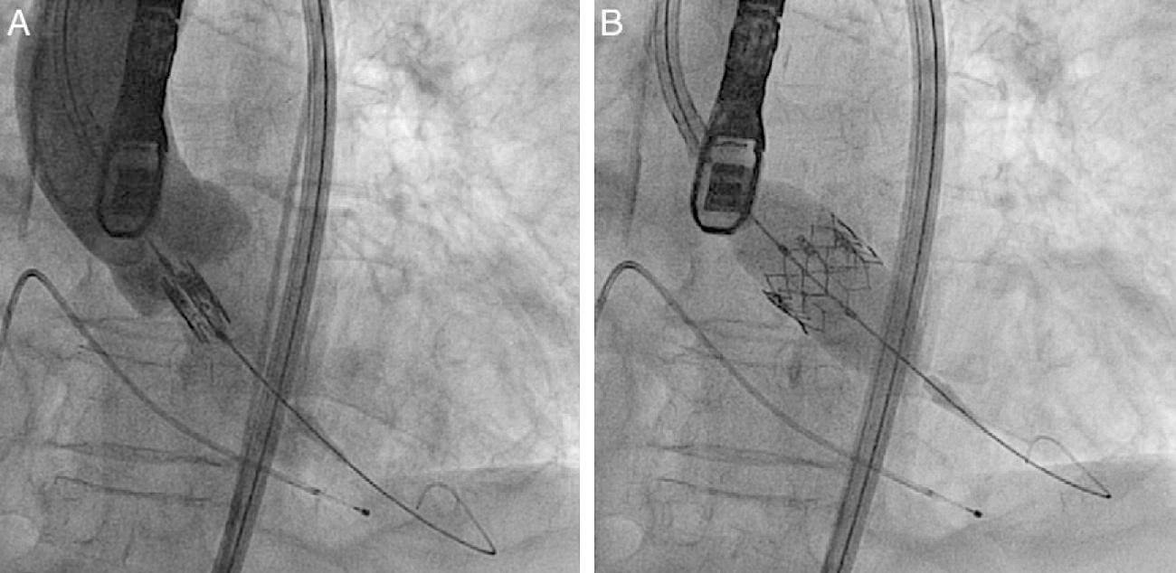
Need 2
Existing Treatment and Problem
percutaneous coronary intervention (PCI)
transcatheter aortic valve implantation (TAVI)
low-risk patients may leave same day
Open-heart valve replacement surgery
stop heart beating
heart/lung machine
several weeks recovery
PROBLEM: vessel measurements may vary based on the phase of the cardiac cycle.
improper valve sizing can lead to perioperative or post-operative
complications such as paravalvular aortic regurgitation.

Slide 14
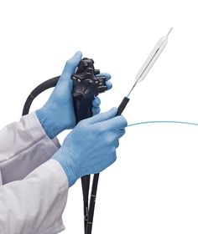
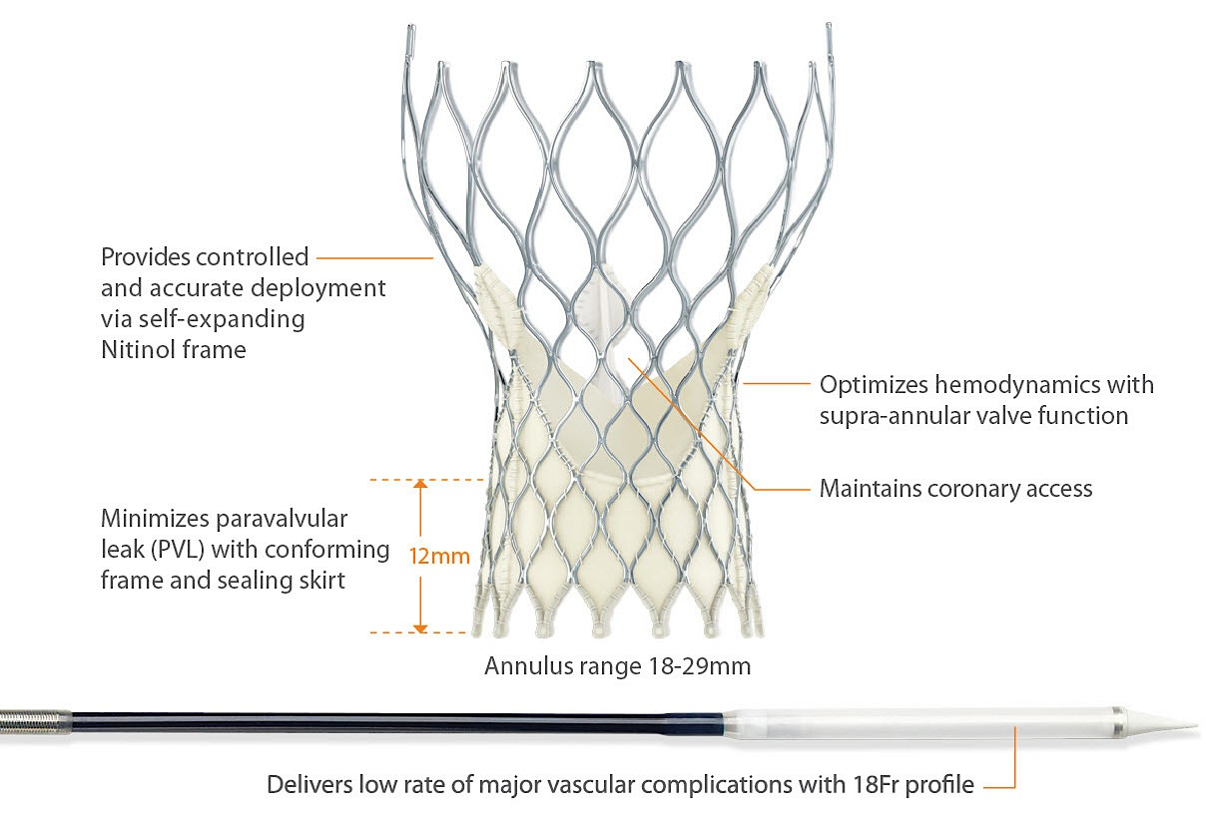
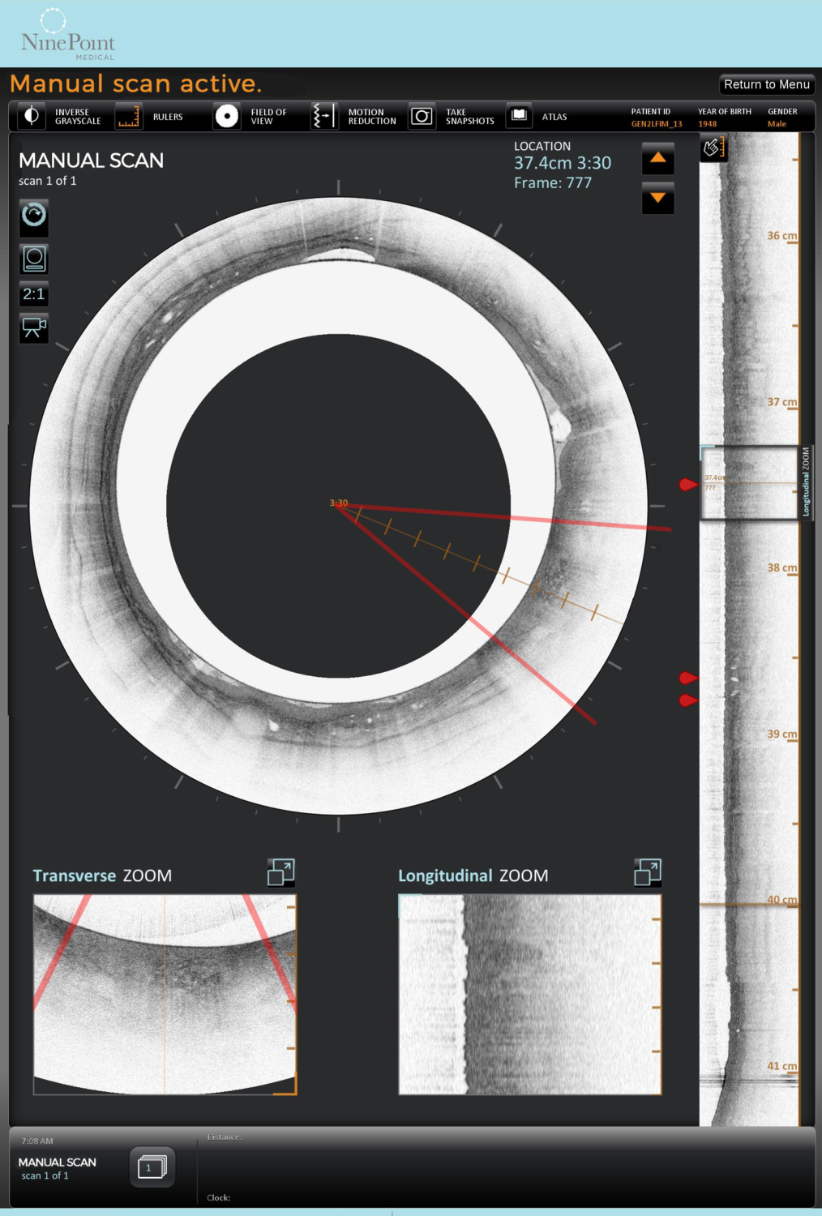
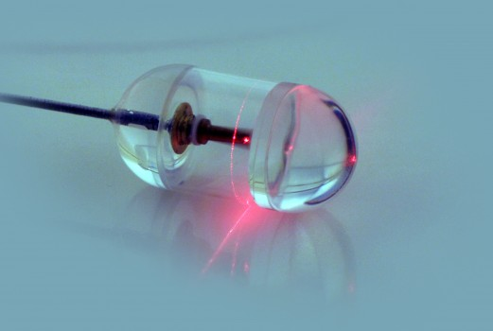
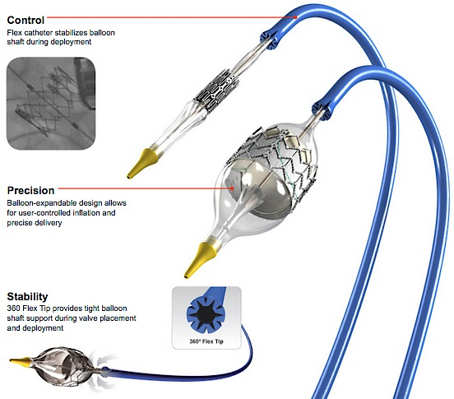
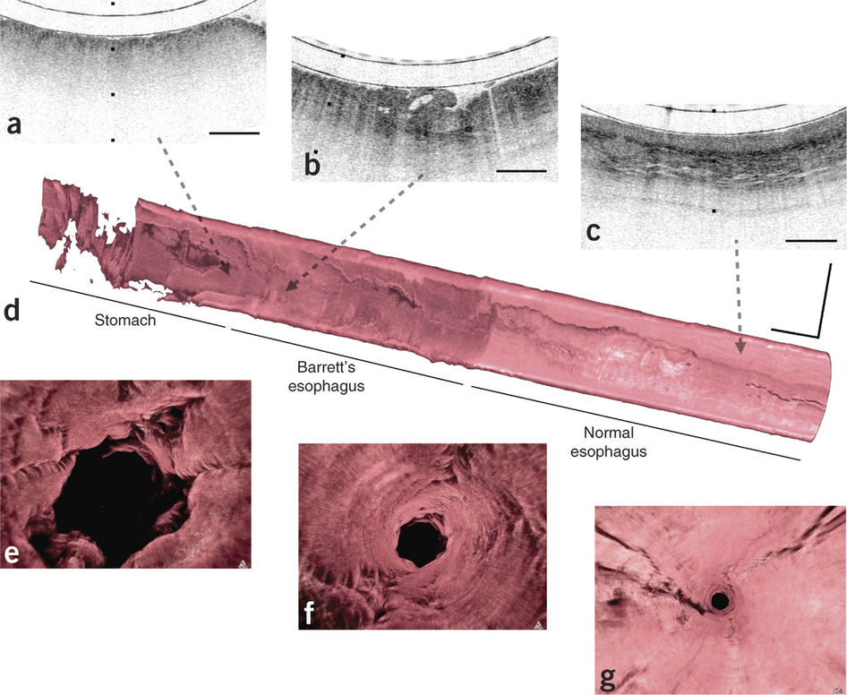
Need 2
Market and Competitors
- Self-expandable Medtronic
CoreValve
Nvision VLE Imaging
System
(NinePoint Medical)
- Balloon-expandable Edwards
SAPIEN XT valve
- Edwards NovaFlex+ catheter
Tethered Capsule Endomicroscopy
(Harvard Medical School)
*CT Scanners: GE Healthcare, Philips, Siemens, Toshiba*

Slide 15
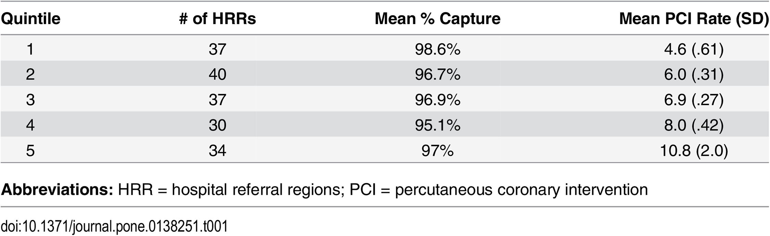
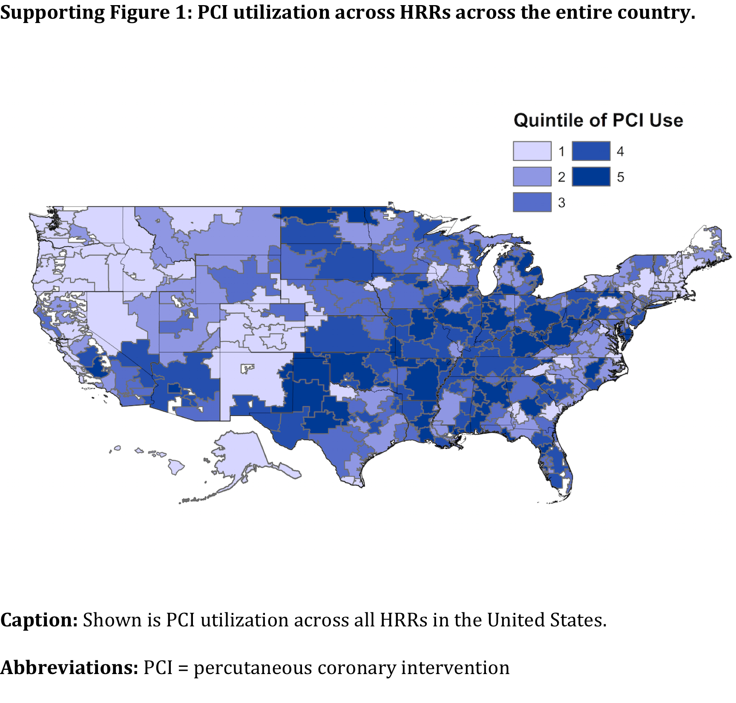
Need 2
Market and Competitors
Matlock, D.D., et al. JAMA. 2013; 310(2):155-62.

Slide 16

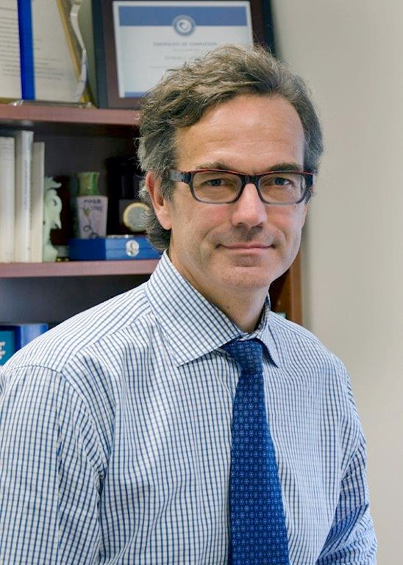
Need 2
Classification and Applicable Regulations
Balloon Aortic Valvuloplasty catheter | Nvision VLE Imaging System (NinePoint Medical)
Device Classification: II Product Code: OZT Regulation Number: 870.1255 | Device Classification: II Product Code: NQQ Regulation: 21 CFR 892.1560
Need Criteria:
Have to be able to insert a diagnostic tool into a vessel that may be highly calcified.
Should be able to take a 360° measurment of the vessel diameter for sizing
Key Opinion Leaders:

Slide 17
Need 3:
A way to reduce the tediousness of counting surgical instruments in every surgery, which will increase the efficiency of medical procedures, lighten the workload of operating room staff, and decrease surgical complications caused by human error.
Background:
Counting all surgical instruments before and at the end of surgery is an important process for every surgery.
Retained surgical instrument (RSI) could lead to severe problems to patients.
At present, the surgical instruments counting process generally is undertaken by human, thus, mistakes is inevitable.
Mistakes in instruments counts happened in 12.5% of surgeries. – Annals of Surgery

Slide 18
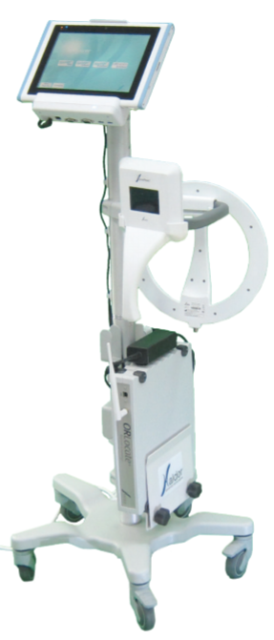
Need 3
Existing Treatment and Problem
Israel RFID (radio frequency identification) medical solution provider Haldor Advanced Technologies developed ORLocate system based on passive RFID tags, it can monitor and track the surgical instruments before, during and at the end of the surgical procedure.
Penelope robot system designed by Micheael R.T can also count surgical instruments.
Most existing solutions are based on ceramic RFID tag.
Need to change the manufacturing process of surgical instruments.
Complex and the price is pretty high.

Slide 19
Need 3
Market and Competitors
48 million surgical inpatient procedures were performed in the United States in 2009. – National Center for Health Statistics
The number of cases in which surgical instruments are left behind during a procedure in the United States has been estimated at around 1500 cases per year, while approximately 88% of these cases occur in a situation where the surgical instruments counts were declared “correct”.
The compensation costs associated with RSI are high. Costs vary from $37,041 to $ 2,350,000 per incident, with an average cost per case estimated at $95,000.
48 million surgical inpatient procedures were performed in the United States in 2009. – National Center for Health Statistics
The number of cases in which surgical instruments are left behind during a procedure in the United States has been estimated at around 1500 cases per year, while approximately 88% of these cases occur in a situation where the surgical instruments counts were declared “correct”.
The compensation costs associated with RSI are high. Costs vary from $37,041 to $ 2,350,000 per incident, with an average cost per case estimated at $95,000.
A more accurate and efficient surgical counting approach would help to save these costs and benefit to both patients and hospitals.

Slide 20
Need 3
Classification and Applicable Regulations
FDA-CDRH | CE | HEALTH CANADA
Device Classification: 1 Product Code: LWH Regulation Number: CFR 880.2740 | Device Classification: I Regulation: EEC/2017/745 | Device Classification: I Regulation: CMDCAS
Need Criteria:
The aiming approach should not change the fabrication process of surgical instruments.
The aiming approach should be more accurate than these existing approaches.
The aiming approach should be easy to use.
The aiming approach should be low-cost.

Slide 21
Need 4:
A way to address the lack of immersive simulations during the training of OR staff, students and residents, in order to accelerate their acquaintance with new instruments/sets and improve both communication and efficiency in the OR.
Problem status:
A lot of time is quickly lost in the OR by human errors : bad communication, misunderstanding, bad nursing, technical errors buy surgeon, lack of knowledges, etc.
Contribution margin/hour of op. time = (hospital income generated by a surgical case) – (all variable costs of hospitalization and supply) → 62USD/min in OR !
A lot of people are quite unexperimented for their first experience in OR.
Notes:
Problem : not enough immersive staff
Population : OR staff, students and residents formations
Outcome : faster acquaintance with instruments/sets, OR staff more efficient in the OR, better communication between the staff

Slide 22
Need 4
Existing Solutions
Longer formations for people in OR : surgeons, anesthetists, specialized nurses, …
An immersive training could be a key step to avoid misunderstanding problems, accelerate the formation and make it more efficient when they work in OR for real.

Slide 23
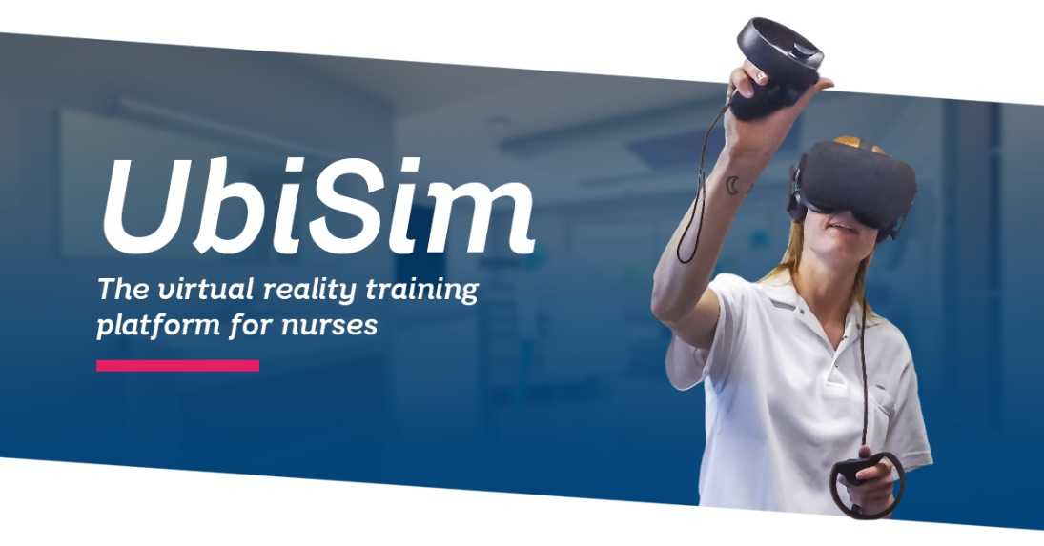
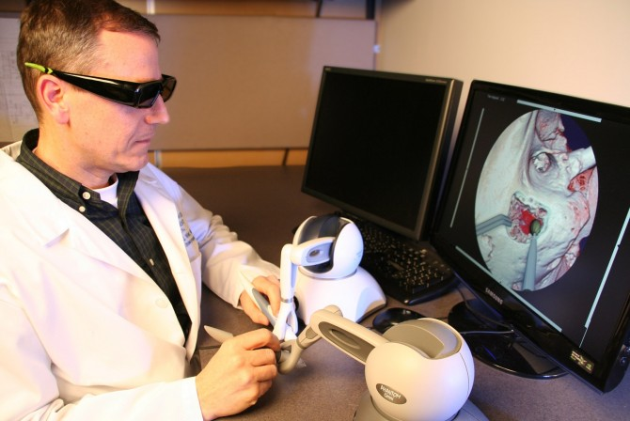
Need 4
Market and Competitors
Immersive training with virtual reality more and more present, especially for surgeons.
E.g.: UbiSim is a new swiss startup for nurse training in VR.
Otherwise, the offer for immersive training is quite limited for the rest of the staff.
Also limited in places where to train : simulation centers not in every medicine school.

Slide 24
Need 4
Classification and Applicable Regulations
FDA-CDRH | CE | HEALTH CANADA
Unclassified | Device Classification: I Regulation: EEC/2017/745 | Device Classification: I Regulation: CMDCAS
Need criteria:
Should be easy to use by anyone, from every background (surgeon, nurse, anesthesist, etc…).
Should have a voice recognition system to interact directly with supervisor of the training or with the trainer.
Should have an interface using more Augmented Reality than Virtual Reality, to be more realistic.

Slide 25
Need 5:
A better way to distinguish vessels that need to undergo Surgery in pre-operative imaging for the percutaneous coronary intervention (PCI) or coronary artery bypass graft (CABG) procedure, in order to speed up diagnosis, and to increase the accuracy of medical professionals in emergency cases.
Disease status:
Coronary artery diseases (also known as CADs) are responsible for nearly 1.5 million heart attack each year in the US alone. Currently, 40 percent of the American population are suffering from a form of cardiovascular diseases. This number is projected to rise up to 46 percent by 2035
CAD is caused by the build-up of cholesterol deposits(plaque) in the wall of the coronary arteries
Hardened plaque narrows the coronary arteries and reduces the flow of oxygen-rich blood to the heart
Coronary artery disease often results in heart attack (myocardial infarction) or chest pain (angina pectoris)

Slide 26
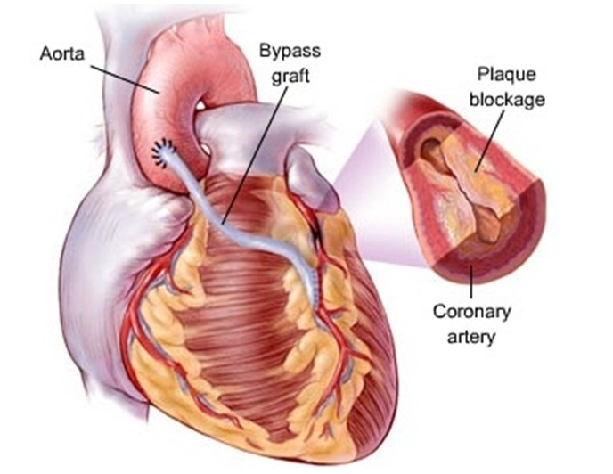
Need 5
Existing Treatment and Problem
Some patients will require invasive treatments such as percutaneous coronary intervention (PCI) where a thin, flexible tube with a balloon at its end or a stent is inserted through the vessel to push the clogging plaque against the wall artery
when the patient can not be treated with PCI, coronary artery bypass surgery (CABG) may be the last option. A healthy artery or vein from the body is grafted, to the blocked coronary artery to bypass blocked portion of that artery
The diagnosis is not always easy to emit
One of the common way is cardiac catheterization. repeating these tests carry some risk to the arteries and the kidneys due to dye injection
CT angiogram is another way to assess blood flow in the heart arteries. Exposure to radiation and the use of dye that can stress the kidneys are downside of this method

Slide 27
Need 5
Classification and Applicable Regulations
FDA-CDRH | CE | HEALTH CANADA
Device Classification: 2 Product Code: IZG Regulation Number: 892.1730 | Device Classification: II Regulation: EEC/2017/745 | Device Classification: II Regulation: CMDCAS
Need Criteria:
the proposed need is subjected to the following criteria:
- Solution which is compatible with the commercially available fluoroscopic angiography system
Implementing a software that can help physicians to diagnose the blocked vessels or the size of the material to be used in PCI and works in real-time for emergency patients
used to note in a more explicit way vessels with a smaller diameter that could require a CABG procedure

Slide 28
Conclusion
A way to more accurately determine the size of a heart valve during transcatheter valve replacement, in order to increase the accuracy and efficiency of choosing the proper valve
Balloon Aortic Valvuloplasty catheter | Nvision VLE Imaging System (NinePoint Medical)
Device Classification: II Product Code: OZT Regulation Number: 870.1255 | Device Classification: II Product Code: NQQ Regulation: 21 CFR 892.1560

Slide 29
CARDIOVASCULAR TEAM
Thank You…

